Slide 1


Telco Customer Churn Analyis
Ironhack Mid-Project
David Arques
June 2024

Slide 2

Agenda
Project Overview:
Goal & Context
Problem Statement
Data Exploration:
Demographics
Customer Segmentation
Billing
Correlations:
Bivariate Analysis
Machine Learning
Conclusions

Slide 3

Project Overview
Goal | Analyze the Telco Customer Churn dataset to gain valuable insights and identify specific business actions to reduce customer churn.
Context | Customer churn = Customer leaving Retaining existing customers is more important than acquiring new ones (Product-Led mindset)
Problem Statement | How can we reduce customer churn using data-driven insights and action-oriented analysis?

Slide 4
Dataset 💾
Kaggle: Telco Customer Churn
+7K customer and 20 Features
Demographics 🧑‍🤝‍🧑 | Service/Tech 📡 | Billing 💵 | Numerical 📈 | Target 🎯
Gender Seniority Partner Dependents | Phone Service Phone lines Internet Service Online Security Online Backup Device Protection Tech Support Streaming TV Streaming Movies | Contract type Paperless Billing Payment Method | Monthly charges Total Charges Tenure | Churn Yes = leaving No = staying
Source: Kaggle Dataset link

Slide 5


Data Exploration
(EDA)

Slide 6
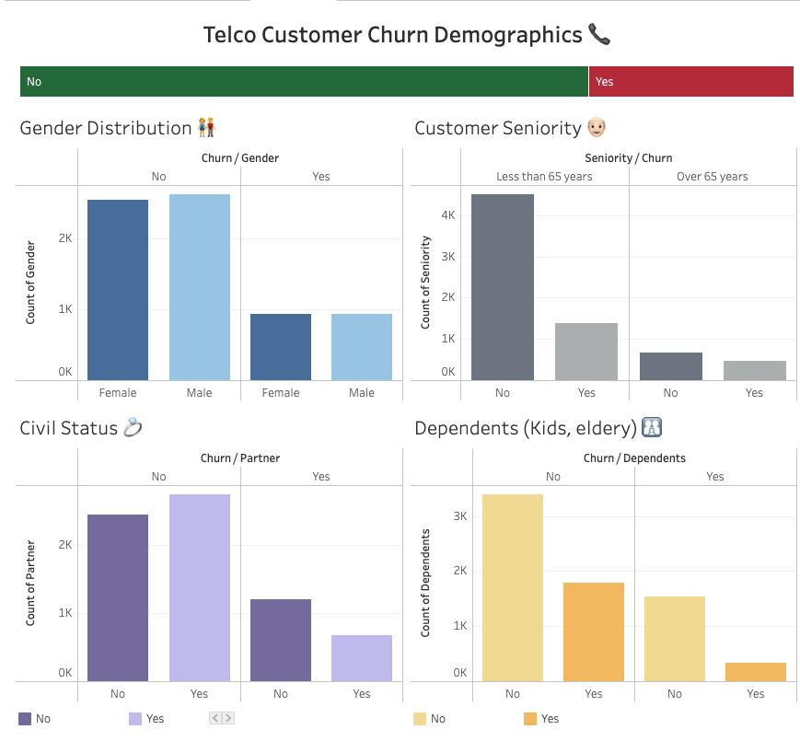

Exploration: Demographics
Interactive customer Demographics Dashboard
by churn

Slide 7
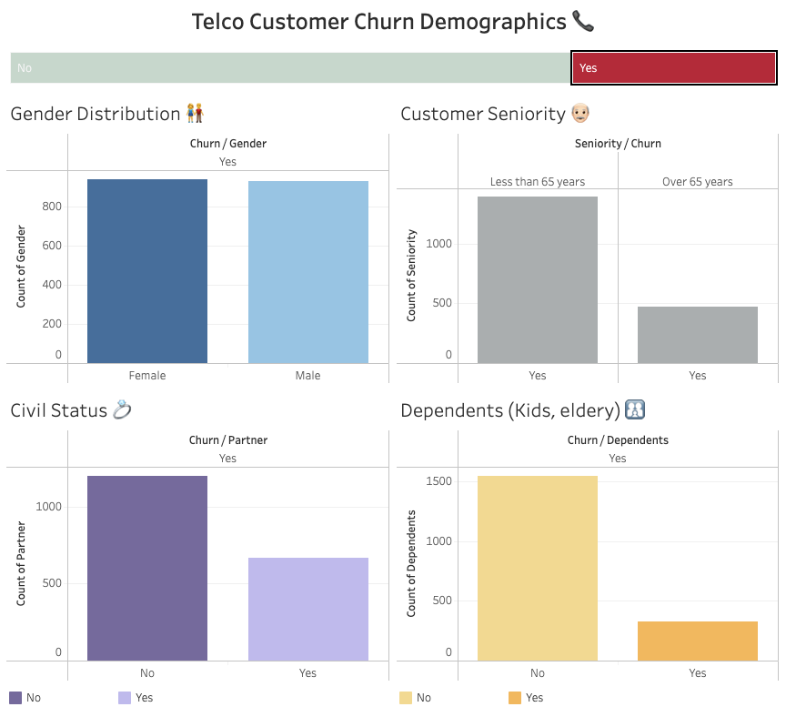
Findings: Demographics 🧑‍🤝‍🧑
What types of customers are leaving?
Gender 👫
The gender distribution is almost 50/50, so not very relevant.
Seniority 👴🏻
Most customers leaving are below 65 years old. However, since approximately 80% of our overall data consists of people below 65 (so not relevant).
Partener/Dependent 💍👶
Most of the customers leaving (around 65%) are single and have no kids or dependents (about 82%).
Action: Focusing on single people with no marriage or kids is a good target audience to improve customer retention.

Slide 8
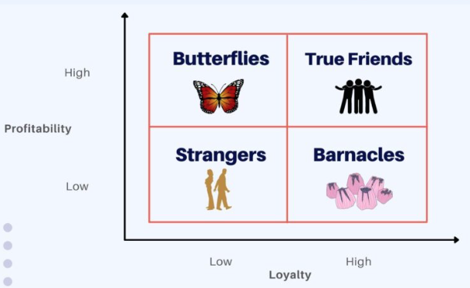
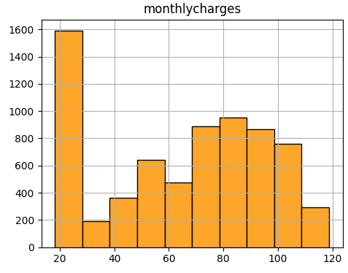
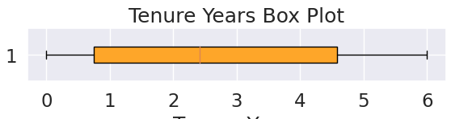
Feature Engineering: Customer Segmentation
Based on Monthly charges (mean = 64.8)
Based on Tenure (mean = 2.7 years)

Slide 9
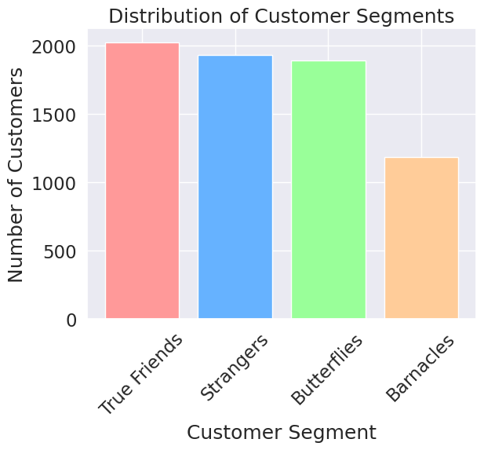
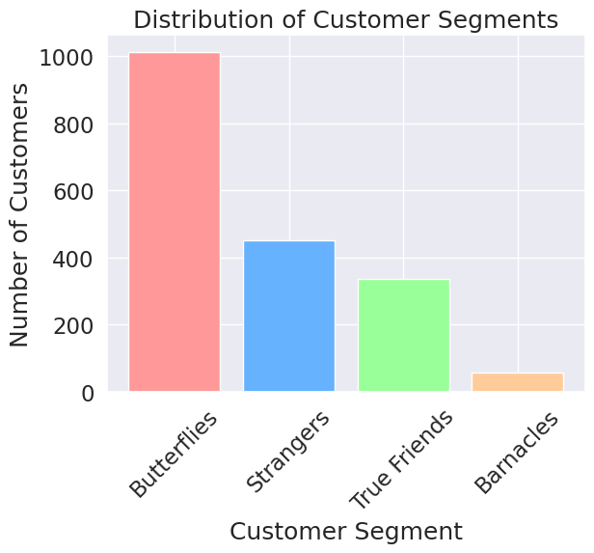
Customer Segmenation Findings
All customer Dataset
Customers leaving (Churn=yes)
Learning: More than half (∼55%) of customers leaving are 'butterflies' 🦋(= highly profitable)
Assessing customer churn is crucial to increasing Telco profit and improving business.

Slide 10
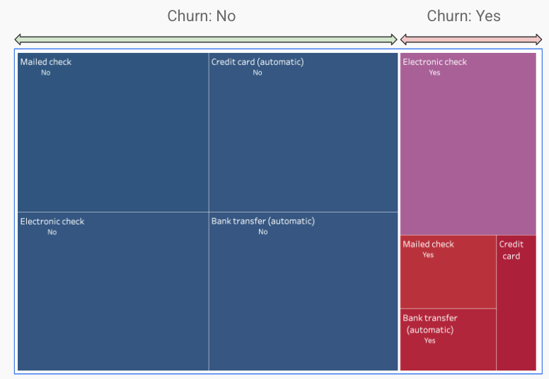

Exploration & Findings: Billing
Insighst: Review the electronic check payment method, as most customers leaving use that one.

Slide 11
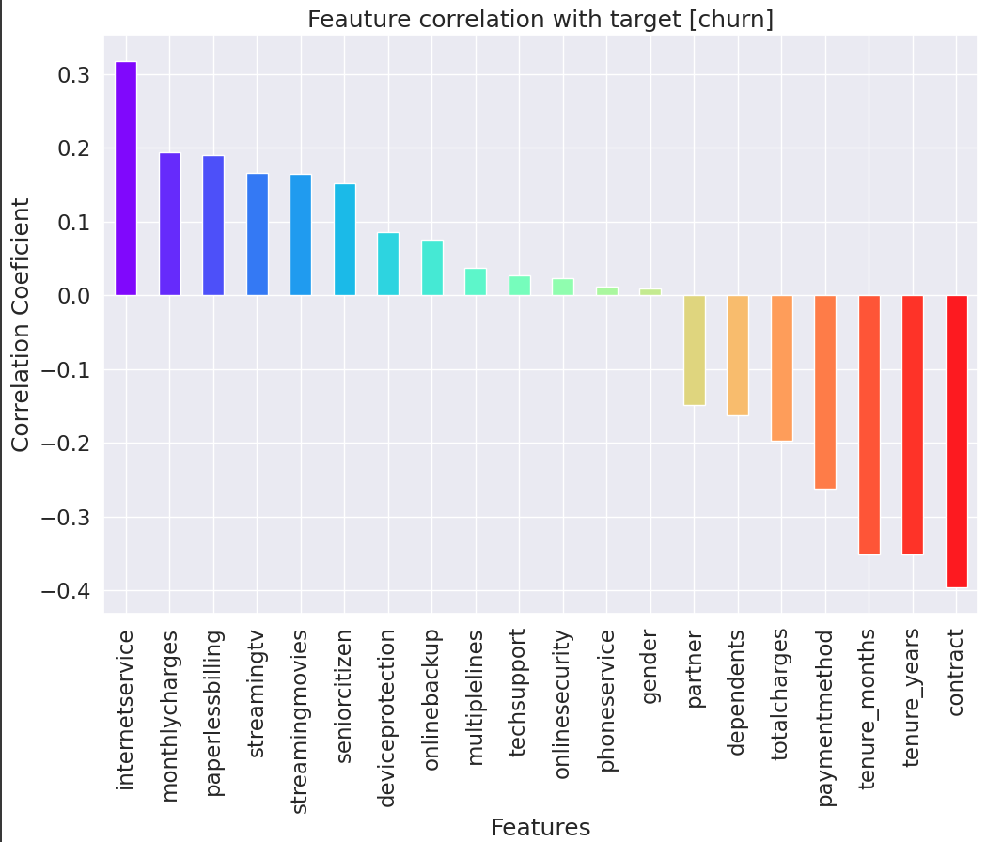

Correlations
Feature correlation assessment with target [churn]
Top correlations to churn:
Contract type (∼0.40)
Internet service (∼0.32)

Slide 12

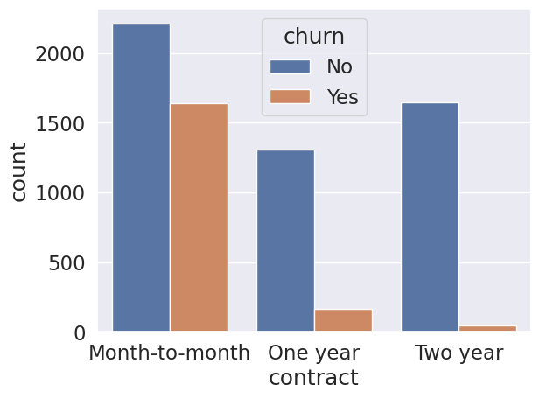
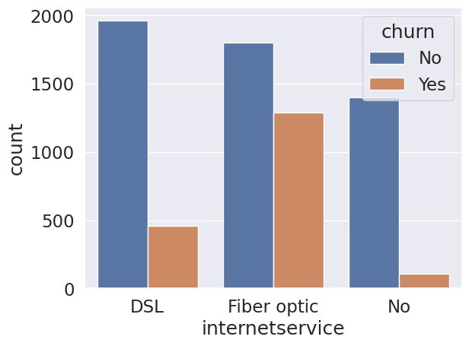
Bivariate Analysis
with High Correlation Features to Target (Churn)
Feature Distribution Visualization
Contract Type
Internet Service

Slide 13

Contract type
Bivariate Analysis results
Chi-Square |  | Cramér's V
Statistic | 1179.80 | Association | 0.40
p-value | 6.44e-257
Contract type distribution with (∼0.40) correlation towards target churn
Conclusions
Chi-square results show strong statistical evidence that contract type is related to customer churn (p-value < 0.05).
Cramer’s V of 0.41 indicates a moderate relationship.
Contract type is not the only driver of churn but significantly influences customer behavior.

Slide 14

Internet Service
Bivariate Analysis results
Chi-Square |  | Cramér's V
Statistic | 732.06 | Association | 0.32
p-value | 1.09e−159
Internet Service distribution with (∼0.32) correlation towards target churn
Conclusions
Chi-square results show moderate statistical evidence that customer’s internet service type is related to churn (p-value < 0.05).
Cramer’s V of 0.32 indicates a moderate to low relationship.
Customer’s internet service type is not as strong as contract type but is still relevant when assessing churn.

Slide 15


Machine Learning
Testing

Slide 16
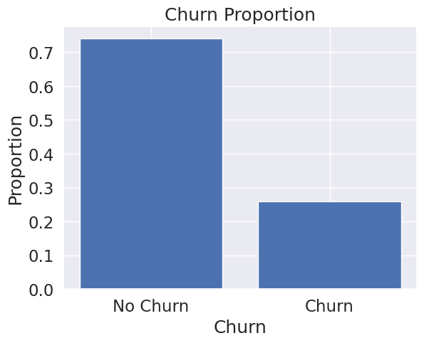
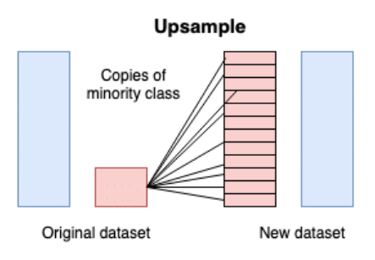
ML Data Overview
ML type 🤖
Classification
70/30 Train-test split
Traget 🎯
Churn (No=0, Yes=1)
Size 📏
7k Customers (Rows)
20 Features (Columns)
Uneven target data. We’ll Apply Oversampling

Slide 17
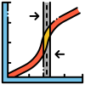
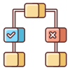
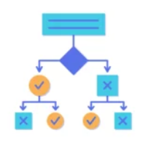
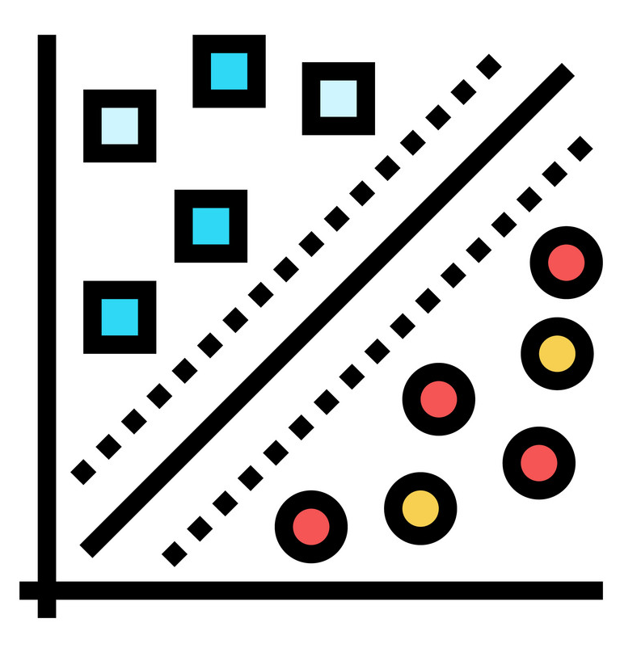
Classification ML models tested
No Data modification
Logistic Regression
Decision Tree Classifier
Support Vector Machine
Upsampling (SMOTE)
Logistic Regression
Random Forest Classifier

Slide 18



ML Results
(No Upsampling)
Logistic Regression
⭐
Test Data accuracy table:
Logistic Regression | Test: 0.79
 | Train: 0.80
Decision Tree | Test: 0.73
 | Train: 0.99
SVC | Test: 0.57
 | Train: 0.58
Decision Tree Classifier
Support Vector Machine (SVC)

Slide 19
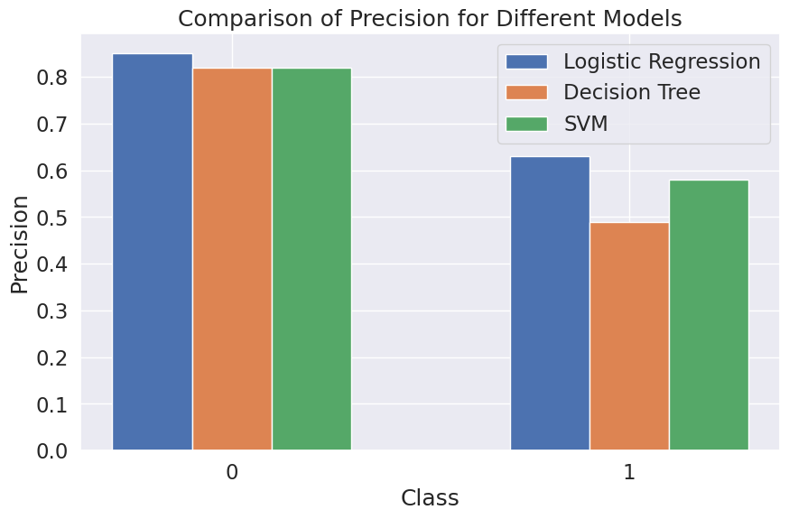
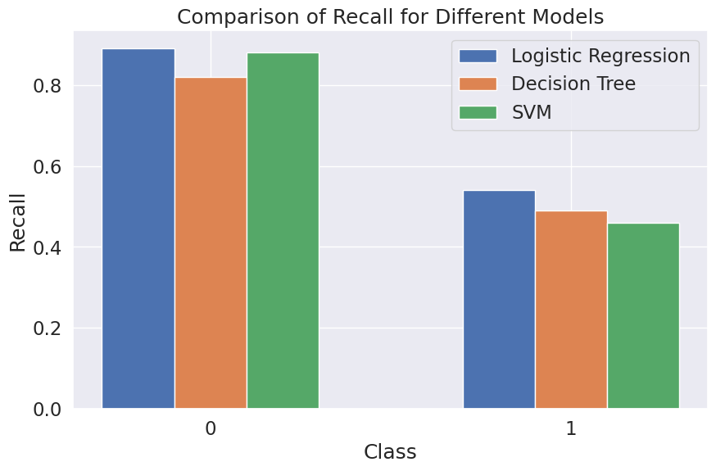
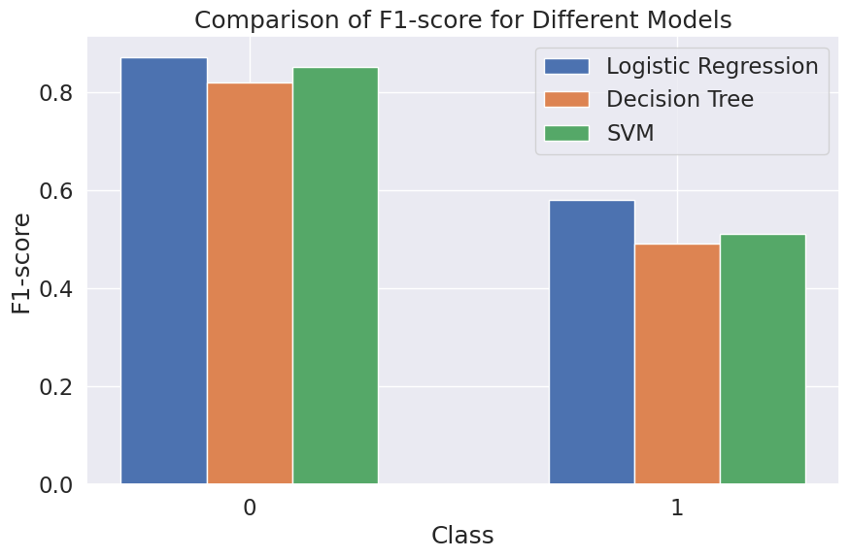
ML Results (No Upsampling)
Conclusions
Logistic regression achieved the best results across all metrics
(Precision, Recall, and F1-score) and Test/Train Accuracy.
We can confirm it is the best ML model out of the three tested.

Slide 20
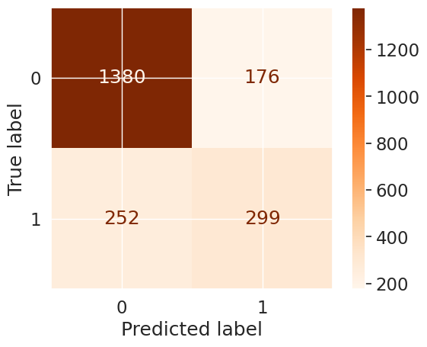
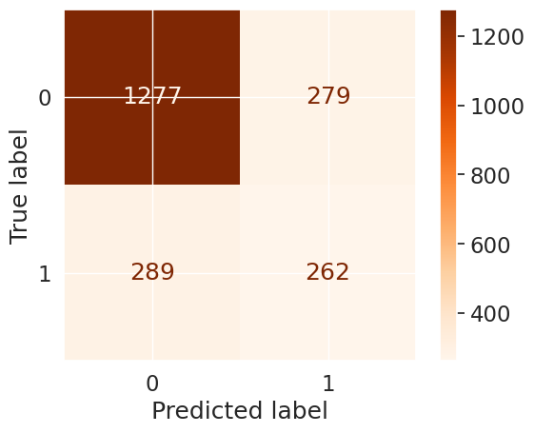
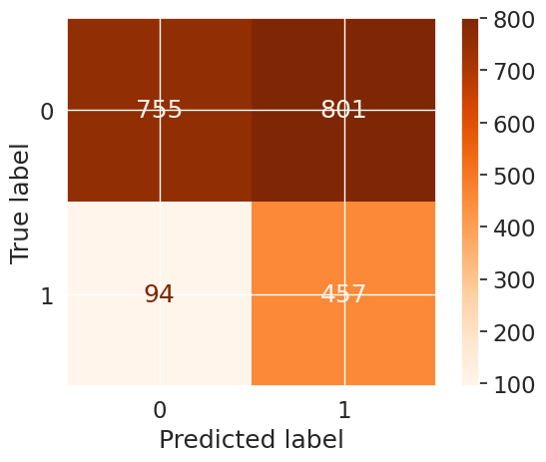
Confusion Metrics (No Upsampling)
Better model ⭐

Slide 21


ML Results
Upsampling (SMOTE)
Logistic Regression
Test Data accuracy table:
Logistic Regression | Test: 0.79
 | Train: 0.80
Random Forest | Test: 0.85
 | Train: 0.99
SMOTE
Random Forest Classifier

Slide 22
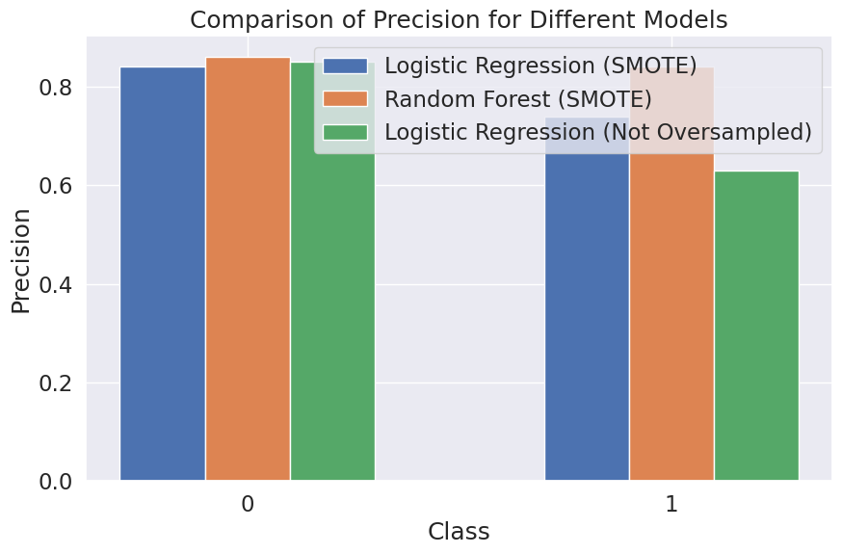
ML Results (No Upsampling)
Conclusions
After upsampling, the best tested model is the Random Forest classifier.
Precision metrics increased significantly:
0.86 for "Churn No"
0.84 for "Churn Yes"
Therefore, it is a better model.

Slide 23
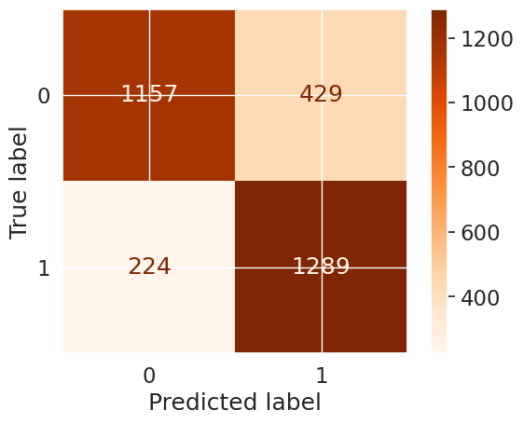
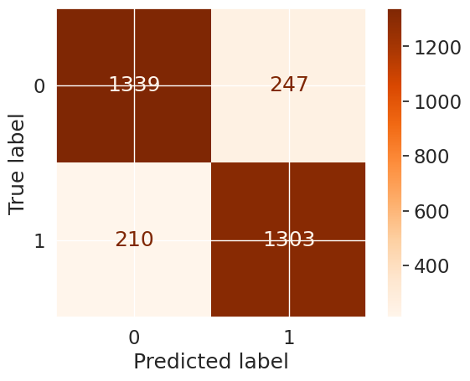
Confusion Metrics (No Upsampling)
SMOTE
Better model ⭐

Slide 24
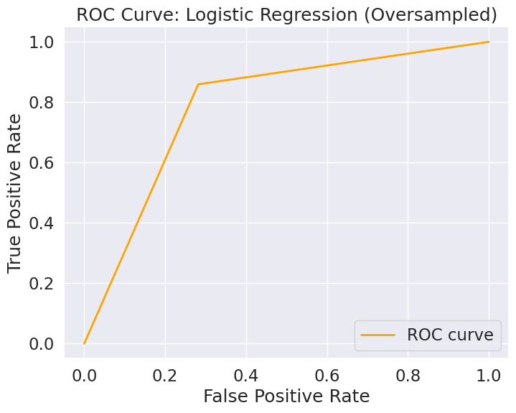
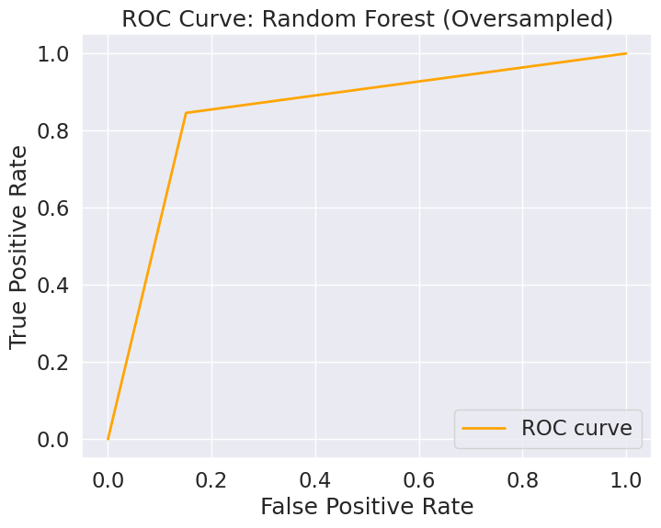
ROC Curve Plotting
SMOTE

Slide 25

Key Takeaways
Data Exploration:
Demographics are not key features to understand customer churn.
Potential target audience for improvement: single people with no kids/dependents.
Customer segmentation highlights the importance of assessing customer churn.
More than half of our customers leaving are highly profitable (spending more than average)
57% of customers leaving use electronic check as a payment method (= Room for improvement)
Correlation:
Key features related to customer churn: contract type and internet service type.
Contract type has a moderate relationship with churn. Focus on pitching longer-term contracts (two years) which have the lowest churn rate.
Machine Learning Models:
Upsampling is crucial for assessing machine learning models due to significant data imbalance (70/30 split).
Random Forest classifier using SMOTE upsampling is the best option for building an accurate model to predict customer churn.

Slide 26
Thank you

